Slide 1

Wireless Networking
Ambuj Varshney
ambujv@nus.edu.sg
Notes:
++ Thank you for inviting me to give this talk
++ In this talk, I will present a pathway that can enable us to make wireless embedded systems ubiquitous. I will describe my previous research efforts that tackle the critical challenges that limit the growth of wireless embedded systems. These are related to the growing energy asymmetry that exists between sensing, computation and communication blocks on these platforms.
++ Finally, I will conclude my talk by covering the research agenda that I would like to work on as a faculty member.

Slide 2
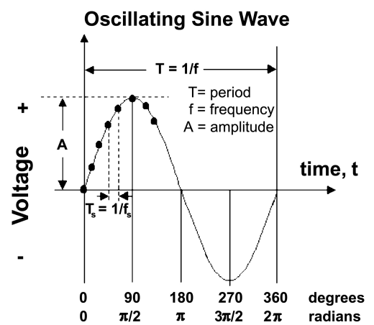
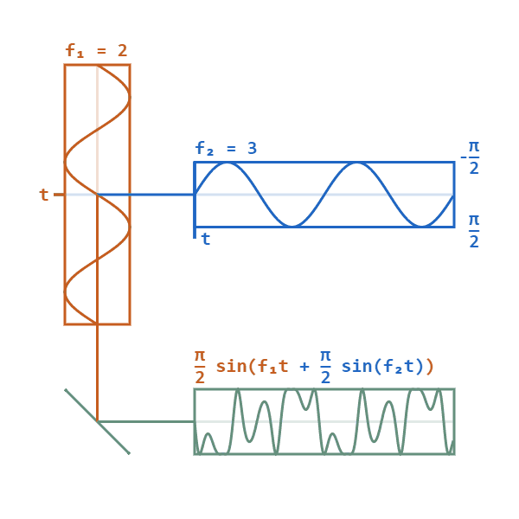
Phase modulation: vary phase of carrier signal
Change phase of a carrier signal according to the message signal
It is an integral part of modern communication standards: WiFi, Television
Advantages (over FM): Better SNR, spectral efficiency
Notes:
First, we look at the computational elements, and these consist of a microcontroller or an FPGA. Today, we find that these computational elements consume at least one order of magnitude higher power consumption when compared to the commonly used sensors.
However, we also find that microcontrollers are increasingly becoming energy efficient. We investigate a typical microcontroller that has been used in sensor platforms over the past two decades. We find that energy efficiency has improved by almost two orders of magnitude. Some of the present-generation microcontrollers, such as Ambiq Apollo4 consume just 3 uA/MHz than 330 uA for MSP430 used on platforms such as TelOS B.
If the trend continues, we can expect the microcontrollers to catch up with the sensors and become energy-efficient. This significant improvement is that the digital components are increasing becoming efficient as they follow moore’s law.

Slide 3
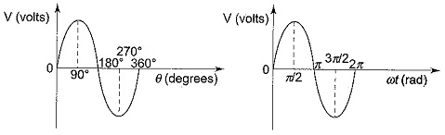
What is phase of a sinusoidal signal?
Phase represents position of point on the waveform cycle
It represents an offset from the starting position of the sine wave
Measured in the unit of radian or degrees
Complete cycle of sine wave is 360 degrees or 2pi radian
Notes:
First, we look at the computational elements, and these consist of a microcontroller or an FPGA. Today, we find that these computational elements consume at least one order of magnitude higher power consumption when compared to the commonly used sensors.
However, we also find that microcontrollers are increasingly becoming energy efficient. We investigate a typical microcontroller that has been used in sensor platforms over the past two decades. We find that energy efficiency has improved by almost two orders of magnitude. Some of the present-generation microcontrollers, such as Ambiq Apollo4 consume just 3 uA/MHz than 330 uA for MSP430 used on platforms such as TelOS B.
If the trend continues, we can expect the microcontrollers to catch up with the sensors and become energy-efficient. This significant improvement is that the digital components are increasing becoming efficient as they follow moore’s law.

Slide 4
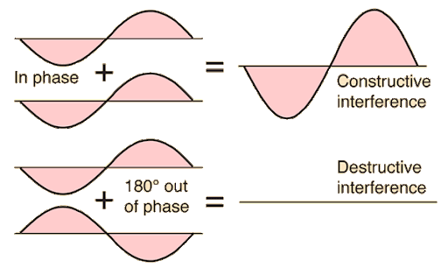
Impact of phase shifts on waves (summation)
Phase shift occurs when the phase of a wave is advanced or delayed
Constructive Interference: When two waves with the same phase add together to form a larger amplitude.
Destructive Interference: When two waves are out-of-phase (e.g., 180° apart) and cancel each other.
Notes:
First, we look at the computational elements, and these consist of a microcontroller or an FPGA. Today, we find that these computational elements consume at least one order of magnitude higher power consumption when compared to the commonly used sensors.
However, we also find that microcontrollers are increasingly becoming energy efficient. We investigate a typical microcontroller that has been used in sensor platforms over the past two decades. We find that energy efficiency has improved by almost two orders of magnitude. Some of the present-generation microcontrollers, such as Ambiq Apollo4 consume just 3 uA/MHz than 330 uA for MSP430 used on platforms such as TelOS B.
If the trend continues, we can expect the microcontrollers to catch up with the sensors and become energy-efficient. This significant improvement is that the digital components are increasing becoming efficient as they follow moore’s law.

Slide 5
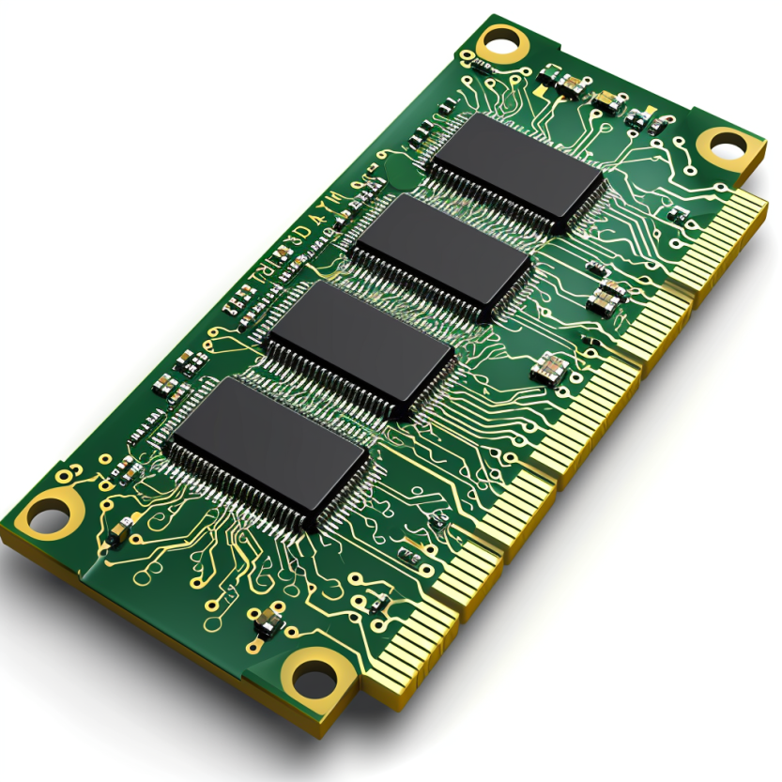
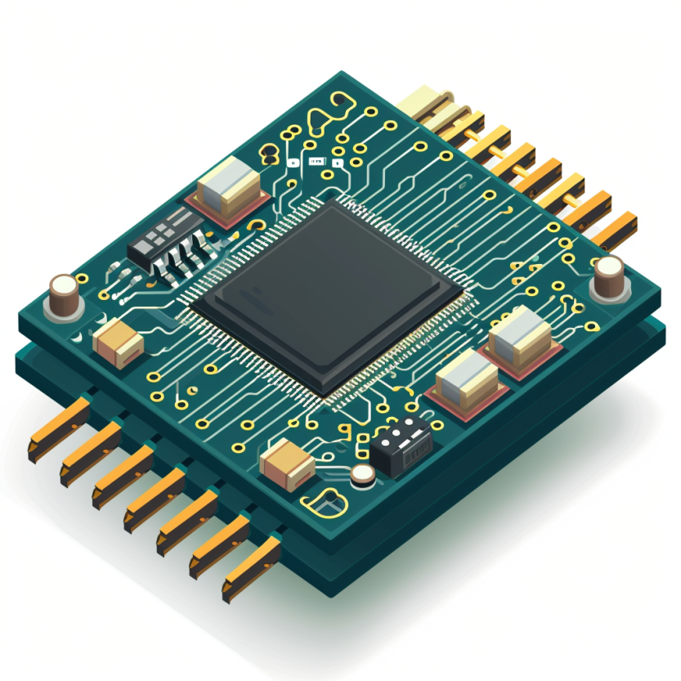




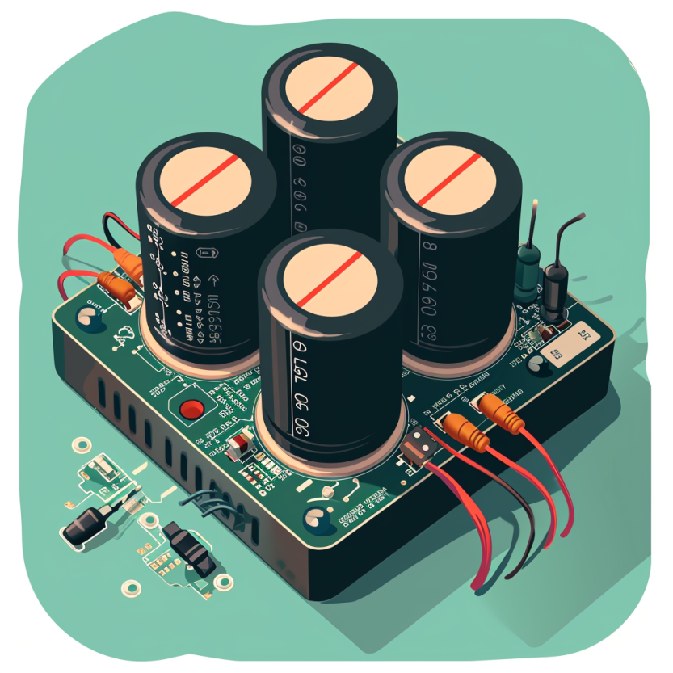
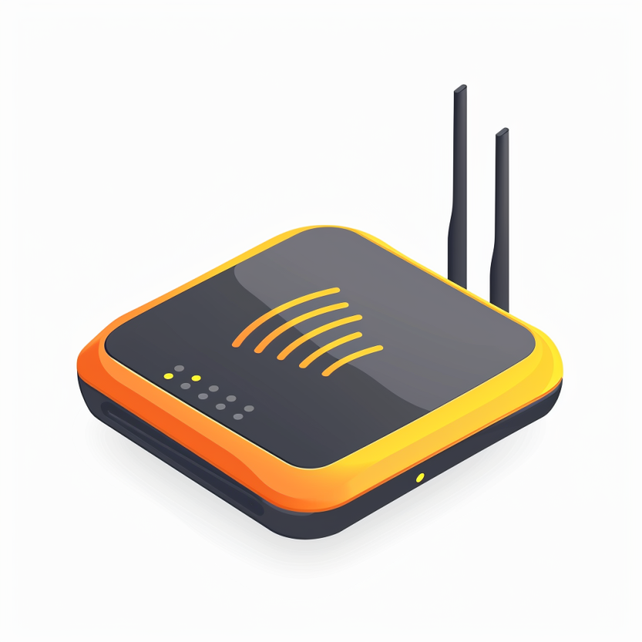

Four main tasks performed by an embedded device
Computation and Storage
Sensing and Actuation
Power
Management
Wireless Networking
Notes:
First, we look at the computational elements, and these consist of a microcontroller or an FPGA. Today, we find that these computational elements consume at least one order of magnitude higher power consumption when compared to the commonly used sensors.
However, we also find that microcontrollers are increasingly becoming energy efficient. We investigate a typical microcontroller that has been used in sensor platforms over the past two decades. We find that energy efficiency has improved by almost two orders of magnitude. Some of the present-generation microcontrollers, such as Ambiq Apollo4 consume just 3 uA/MHz than 330 uA for MSP430 used on platforms such as TelOS B.
If the trend continues, we can expect the microcontrollers to catch up with the sensors and become energy-efficient. This significant improvement is that the digital components are increasing becoming efficient as they follow moore’s law.

Slide 6
So, what are sensors ?
They are an eyes and ears for an embedded device. They sense environment and help to understand the physical world. Sensor is an electronic component that measures a physical phenomenon.
What are the phenomenon that you would like to sense and measure?
Temperature
Humidity
Acoustic
Vital signs
…….
Choice of sensor depends on the target embedded application
Notes:
First, we look at the computational elements, and these consist of a microcontroller or an FPGA. Today, we find that these computational elements consume at least one order of magnitude higher power consumption when compared to the commonly used sensors.
However, we also find that microcontrollers are increasingly becoming energy efficient. We investigate a typical microcontroller that has been used in sensor platforms over the past two decades. We find that energy efficiency has improved by almost two orders of magnitude. Some of the present-generation microcontrollers, such as Ambiq Apollo4 consume just 3 uA/MHz than 330 uA for MSP430 used on platforms such as TelOS B.
If the trend continues, we can expect the microcontrollers to catch up with the sensors and become energy-efficient. This significant improvement is that the digital components are increasing becoming efficient as they follow moore’s law.

Slide 7
Models of Sensors
Many sensors can be modelled approximately as an affine function
f : R → R
x(t) : Physical Quantity reported by sensor at the time instance t
f(x(t)): Value reported by sensor for the particular physical quantity
Function f is linear if there exists proportionality constant a ∈ R
such that for all x(t) ∈ R, f(x(t)) = ax(t)
Notes:
First, we look at the computational elements, and these consist of a microcontroller or an FPGA. Today, we find that these computational elements consume at least one order of magnitude higher power consumption when compared to the commonly used sensors.
However, we also find that microcontrollers are increasingly becoming energy efficient. We investigate a typical microcontroller that has been used in sensor platforms over the past two decades. We find that energy efficiency has improved by almost two orders of magnitude. Some of the present-generation microcontrollers, such as Ambiq Apollo4 consume just 3 uA/MHz than 330 uA for MSP430 used on platforms such as TelOS B.
If the trend continues, we can expect the microcontrollers to catch up with the sensors and become energy-efficient. This significant improvement is that the digital components are increasing becoming efficient as they follow moore’s law.

Slide 8
Models of Sensors
Is every linear function an affine function?
NO
Every affine function is a linear function
Interpreting of the sensor readings needs an understanding of the proportionality constant and bias in the affine function
Notes:
First, we look at the computational elements, and these consist of a microcontroller or an FPGA. Today, we find that these computational elements consume at least one order of magnitude higher power consumption when compared to the commonly used sensors.
However, we also find that microcontrollers are increasingly becoming energy efficient. We investigate a typical microcontroller that has been used in sensor platforms over the past two decades. We find that energy efficiency has improved by almost two orders of magnitude. Some of the present-generation microcontrollers, such as Ambiq Apollo4 consume just 3 uA/MHz than 330 uA for MSP430 used on platforms such as TelOS B.
If the trend continues, we can expect the microcontrollers to catch up with the sensors and become energy-efficient. This significant improvement is that the digital components are increasing becoming efficient as they follow moore’s law.

Slide 9
Models of Sensors
f(x(t)) = ax(t) + b
What does proportionality constant a represent?
Sensitivity of the sensor. Specifies degree to which the sensor reading changes in correspondence to the change in the physical quantity
Notes:
First, we look at the computational elements, and these consist of a microcontroller or an FPGA. Today, we find that these computational elements consume at least one order of magnitude higher power consumption when compared to the commonly used sensors.
However, we also find that microcontrollers are increasingly becoming energy efficient. We investigate a typical microcontroller that has been used in sensor platforms over the past two decades. We find that energy efficiency has improved by almost two orders of magnitude. Some of the present-generation microcontrollers, such as Ambiq Apollo4 consume just 3 uA/MHz than 330 uA for MSP430 used on platforms such as TelOS B.
If the trend continues, we can expect the microcontrollers to catch up with the sensors and become energy-efficient. This significant improvement is that the digital components are increasing becoming efficient as they follow moore’s law.

Slide 10
Does affine model always hold for a sensor?
No sensor truly realizes an affine function. The range of a sensor, the set of values of a physical quantity that it can measure, is always limited
Outside that range, an affine function model is no longer valid
Example: A thermometer may have a range of −20◦ to 50◦ Celsius. Physical quantities outside this range will typically saturate, meaning that they yield a maximum or a minimum reading outside their range or they saturate in readings. How do we represent the sensor function?
Notes:
First, we look at the computational elements, and these consist of a microcontroller or an FPGA. Today, we find that these computational elements consume at least one order of magnitude higher power consumption when compared to the commonly used sensors.
However, we also find that microcontrollers are increasingly becoming energy efficient. We investigate a typical microcontroller that has been used in sensor platforms over the past two decades. We find that energy efficiency has improved by almost two orders of magnitude. Some of the present-generation microcontrollers, such as Ambiq Apollo4 consume just 3 uA/MHz than 330 uA for MSP430 used on platforms such as TelOS B.
If the trend continues, we can expect the microcontrollers to catch up with the sensors and become energy-efficient. This significant improvement is that the digital components are increasing becoming efficient as they follow moore’s law.

Slide 11

Example
A light sensor follows an affine model:
Where L_{measured} is the sensor’s output, L_{true} is the actual illuminance (in lux), and the parameters alpha and beta need to be determined. The sensor provides the following readings:
At 100 lux: 120 lux, At 300 lux: 340 lux
(a) Determine the calibration parameters alpha beta
(b) What will the sensor read at 200 lux?
Notes:
First, we look at the computational elements, and these consist of a microcontroller or an FPGA. Today, we find that these computational elements consume at least one order of magnitude higher power consumption when compared to the commonly used sensors.
However, we also find that microcontrollers are increasingly becoming energy efficient. We investigate a typical microcontroller that has been used in sensor platforms over the past two decades. We find that energy efficiency has improved by almost two orders of magnitude. Some of the present-generation microcontrollers, such as Ambiq Apollo4 consume just 3 uA/MHz than 330 uA for MSP430 used on platforms such as TelOS B.
If the trend continues, we can expect the microcontrollers to catch up with the sensors and become energy-efficient. This significant improvement is that the digital components are increasing becoming efficient as they follow moore’s law.

Slide 12
Example
A temperature sensor provides an output voltage V_{out} that is linearly related to the measured temperature T as follows:
Vout = aT + b
Where a = 0.01 V/°C and b = 0.5 V.
(a) What is the temperature when the sensor outputs 0.8V?
(b) If the sensor has an inherent offset error of +0.1V, how does it affect the measured temperature?
Notes:
First, we look at the computational elements, and these consist of a microcontroller or an FPGA. Today, we find that these computational elements consume at least one order of magnitude higher power consumption when compared to the commonly used sensors.
However, we also find that microcontrollers are increasingly becoming energy efficient. We investigate a typical microcontroller that has been used in sensor platforms over the past two decades. We find that energy efficiency has improved by almost two orders of magnitude. Some of the present-generation microcontrollers, such as Ambiq Apollo4 consume just 3 uA/MHz than 330 uA for MSP430 used on platforms such as TelOS B.
If the trend continues, we can expect the microcontrollers to catch up with the sensors and become energy-efficient. This significant improvement is that the digital components are increasing becoming efficient as they follow moore’s law.

Slide 13
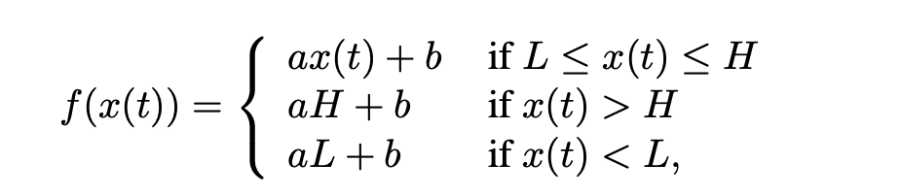
Does affine model always hold for a sensor?
What do you mean by saturation? What is sensor reading ?
Where L, H ∈ R, L < H, are the low and high end of the sensor range
Notes:
First, we look at the computational elements, and these consist of a microcontroller or an FPGA. Today, we find that these computational elements consume at least one order of magnitude higher power consumption when compared to the commonly used sensors.
However, we also find that microcontrollers are increasingly becoming energy efficient. We investigate a typical microcontroller that has been used in sensor platforms over the past two decades. We find that energy efficiency has improved by almost two orders of magnitude. Some of the present-generation microcontrollers, such as Ambiq Apollo4 consume just 3 uA/MHz than 330 uA for MSP430 used on platforms such as TelOS B.
If the trend continues, we can expect the microcontrollers to catch up with the sensors and become energy-efficient. This significant improvement is that the digital components are increasing becoming efficient as they follow moore’s law.

Slide 14
Sensors transform phenomenon into electrical signals
How sensors convert physical phenomena into electrical signals, we refer to Ohm's Law, which states that Voltage (V) equals Current (I) times Resistance (R)
V (Voltage) = I (Current) X R (Resistance)
By altering one of the variables in Ohm’s law —Voltage (V), Current (I), or Resistance (R)—in response to changes in the phenomenon, a sensor generates an analog electrical signal that corresponds to that phenomenon

Slide 15
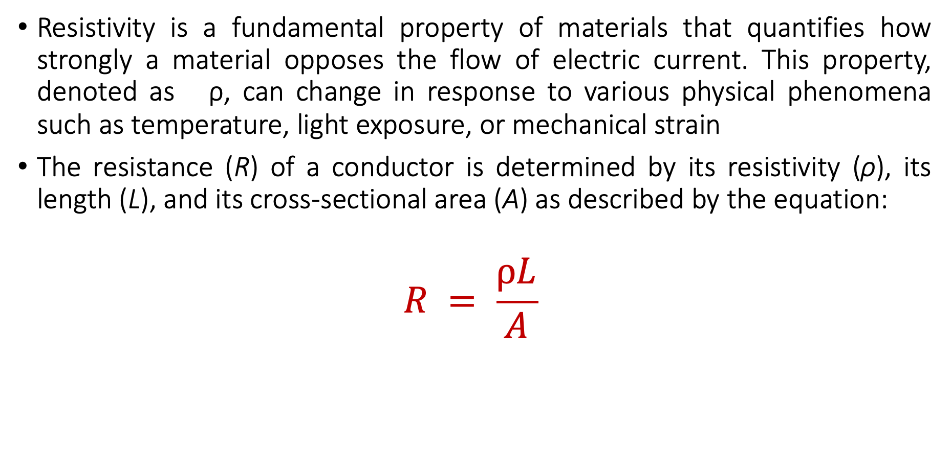
Material Resistivity and its Role in Sensing Phenomena
Resistivity is a fundamental property of materials that quantifies how strongly a material opposes the flow of electric current. This property, denoted as ρ, can change in response to various physical phenomena such as temperature, light exposure, or mechanical strain
The resistance (R) of a conductor is determined by its resistivity (ρ), its length (L), and its cross-sectional area (A) as described by the equation:
$$R = \frac{ρL}{A}$$

Slide 16
Material Resistivity and its Role in Sensing Phenomena
Resistivity (ρ): Materials with higher resistivity create more resistance for the same length and area. Resistivity is sensitive to physical conditions;
Temperature: Many conductors have higher resistivity at higher temperatures.
Light: Some materials (like photoresistors) change their resistivity exposed to light.
Strain: Materials known as strain gauges increase in resistivity when stretched.

Slide 17
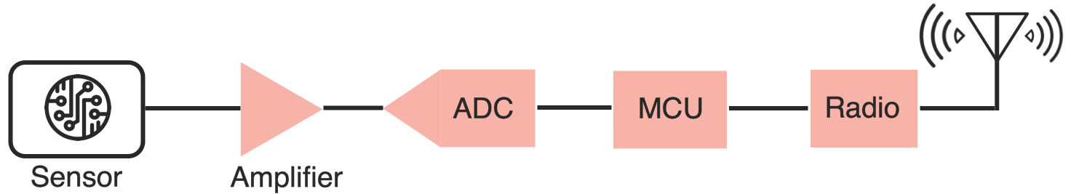
Taking a step back: Microcontrollers are digital
Up to this point, we have talked about translating physical phenomenon to analog electrical signal changes
How do we convert the analog signal into digital?
Do we need to do any processing before the conversion operation?
Conventional and widely used architecture of embedded wireless platform
Notes:
Why do the IoT platforms suffer from this energy challenge? To understand this, we investigate the architecture of the IoT device. We show this architecture in the figure on the slide. It consists of a series of stages that enable us to sense physical phenomena, process and transmit the sensor information through a transceiver such as ZigBee/BLE/LoRa.
This architecture has remained unchanged over the past two decades. We find that during this time, sensors have become exceeding efficient. Today, we find sensors such as an accelerometer or a temperature sensor consumes just a few tens of microwatts of power consumption. However, we find that rest of the architecture components that are shown in red colour remain significantly energy expensive. To understand the reason for this significant energy asymmetry, we look at the following slide.

Slide 18
ADC: Bridging the analog and digital worlds
ADCs convert analog signals, which have a continuous range of values, into digital signals, which have discrete numerical representations. This is essential for digital devices to process real-world analog inputs
What are the various parameters of the ADC?
Resolution: Determined by the number of bits the ADC uses to represent the analog value. More bits mean higher resolution and finer granularity in the output
Sampling Rate: The frequency at which the ADC samples the analog signal. Higher sampling rates can capture more detail and are necessary to comply with the Nyquist theorem. It also means higher power consumption
Accuracy: The closeness of the ADC's output to the true input value. It includes factors such as linearity, noise, and error rate
Notes:
Why do the IoT platforms suffer from this energy challenge? To understand this, we investigate the architecture of the IoT device. We show this architecture in the figure on the slide. It consists of a series of stages that enable us to sense physical phenomena, process and transmit the sensor information through a transceiver such as ZigBee/BLE/LoRa.
This architecture has remained unchanged over the past two decades. We find that during this time, sensors have become exceeding efficient. Today, we find sensors such as an accelerometer or a temperature sensor consumes just a few tens of microwatts of power consumption. However, we find that rest of the architecture components that are shown in red colour remain significantly energy expensive. To understand the reason for this significant energy asymmetry, we look at the following slide.

Slide 19
Digital Sensors
Some sensors incorporate ADC within their circuits to provide digitized signal which then can be read by a microcontroller
Dynamic Range: Digital sensors are unable to distinguish between two closely-spaced values of the physical quantity. The precision p of a sensor is the smallest absolute difference between two values of a physical quantity whose sensor readings are distinguishable

Slide 20
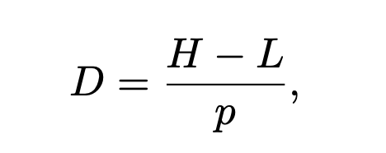
Dynamic Range of Digital Sensors
D ∈ R+ of a digital sensor is the ratio
p = Represents the precision of the sensor

Slide 21
Dynamic Range of Digital Sensors
D ∈ R+ of a digital sensor is the ratio
p = Represents the precision of the sensor
Where H and L are the limits of the range in

Slide 22
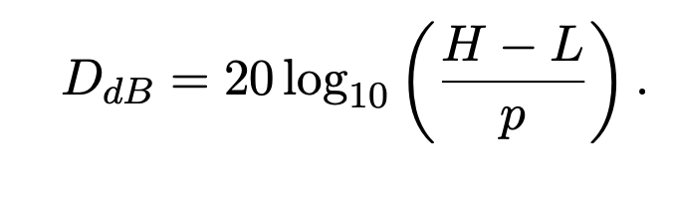
Dynamic Range of Digital Sensors
Dynamic range is often expressed in the unit of decibels
How do you estimate in decibels?

Slide 23
Quantization of sensor readings
Digital sensors represent a physical quantity through a n-bit number
n is a typically a small number, how many values are there?

Slide 24
Quantization of sensor readings
Digital sensors represent a physical quantity through a n-bit number
n is a typically a small number, how many values are there? 2^{n}
Digital sensors can only produce 2^{n} distinct measurements
Actual physical quantity?

Slide 25
Quantization of sensor readings
Digital sensors represent a physical quantity through a n-bit number
n is a typically a small number, how many values are there? 2^{n}
Digital sensors can only produce 2^{n} distinct measurements
Actual physical quantity? represented by a real number x(t) ∈ R

Slide 26
Quantization of sensor readings
Digital sensors represent a physical quantity through a n-bit number
n is a typically a small number, how many values are there? 2^{n}
Digital sensors can only produce 2^{n} distinct measurements
Actual physical quantity? represented by a real number x(t) ∈ R
Digital sensor picks one of the 2^{n} distinct numbers to represent it
Thus the sensor readings are Quantized!

Slide 27
Quantization of sensor readings
Digital sensors represent a physical quantity through a n-bit number
n is a typically a small number, how many values are there? 2^{n}
Digital sensors can only produce 2^{n} distinct measurements
Actual physical quantity? represented by a real number x(t) ∈ R
Digital sensor picks one of the 2^{n} distinct numbers to represent it
Thus the sensor readings are Quantized!

Slide 28
Ideal digital sensor? What should be n and p

Slide 29
Ideal digital sensor? What should be n and p
Ideal digital sensor: two physical quantities that differ by the precision p are represented by digital quantities that differ by one bit
Precision and quantization become intertwined

Slide 30
Example
A temperature sensor has a minimum detectable value of -40°C and a maximum measurable value of 150°C. The sensor has a 12-bit ADC resolution, what is precision, dynamic range?
Notes:
First, we look at the computational elements, and these consist of a microcontroller or an FPGA. Today, we find that these computational elements consume at least one order of magnitude higher power consumption when compared to the commonly used sensors.
However, we also find that microcontrollers are increasingly becoming energy efficient. We investigate a typical microcontroller that has been used in sensor platforms over the past two decades. We find that energy efficiency has improved by almost two orders of magnitude. Some of the present-generation microcontrollers, such as Ambiq Apollo4 consume just 3 uA/MHz than 330 uA for MSP430 used on platforms such as TelOS B.
If the trend continues, we can expect the microcontrollers to catch up with the sensors and become energy-efficient. This significant improvement is that the digital components are increasing becoming efficient as they follow moore’s law.

Slide 31
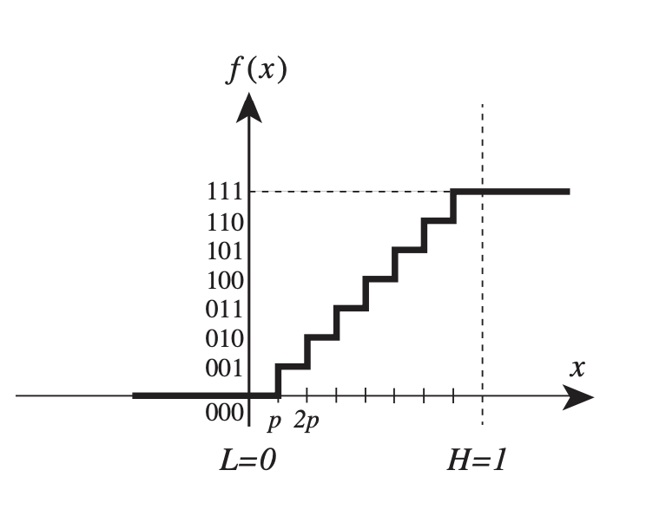
Let us look at an example
Consider a 3-bit digital sensor that can measure a voltage between zero and one volt. Such a sensor may be modelled by the function
f : R → {0, 1, · · · , 7}

Slide 32
Let us look at an example
Consider a 3-bit digital sensor that can measure a voltage between zero and one volt. Such a sensor may be modelled by the function
f : R → {0, 1, · · · , 7}
What is L, H?

Slide 33
Let us look at an example
Consider a 3-bit digital sensor that can measure a voltage between zero and one volt. Such a sensor may be modelled by the function
f : R → {0, 1, · · · , 7}
What is L, H? 0 and 1 (Volts)
What is precision?

Slide 34
Let us look at an example
Consider a 3-bit digital sensor that can measure a voltage between zero and one volt. Such a sensor may be modelled by the function
f : R → {0, 1, · · · , 7}
What is L, H? 0 and 1 (Volts)
What is precision? 1/8
What is the dynamic range?

Slide 35
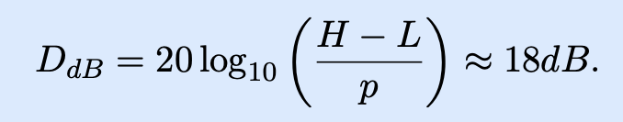
Let us look at an example
Consider a 3-bit digital sensor that can measure a voltage between zero and one volt. Such a sensor may be modelled by the function
f : R → {0, 1, · · · , 7}
What is L, H? 0 and 1 (Volts)
What is precision? 1/8
What is the dynamic range?

Slide 36
Sensor Distortion Function
Defines the output of sensor as a function of input
f : R → {0, 1, · · · , 7}
For sensors with output similar to above (occurs often) has precision given by the following formula: p = (H − L)/2 ^{n}

Slide 37
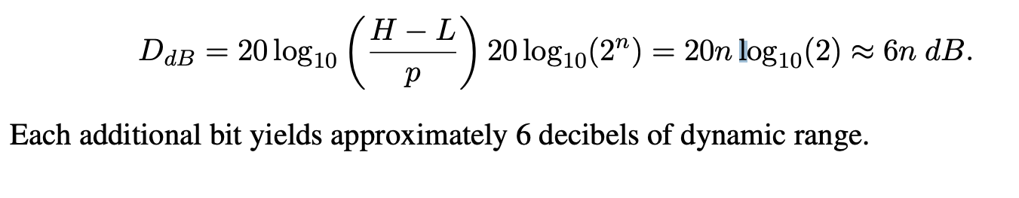
Sensor Distortion Function
Defines the output of sensor as a function of input
f : R → {0, 1, · · · , 7}
For sensors with output similar to above (occurs often) has precision given by the following formula:
p = (H − L)/2 ^{n}

Slide 38
Sampling through analog to digital converter
Physical quantity x(t) is a function of time t
A digital sensor will sample the physical quantity at particular points in time to create a discrete signal
Uniform sampling, there is a fixed time interval T between samples;
T is called the sampling interval.
The resulting signal may be modelled as a function s: Z → R
∀ n ∈ Z, s(n) = f(x(nT)),
Physical quantity x(t) is observed only at times t = nT

Slide 39
Sampling through analog to digital converter
The resulting signal may be modelled as a function s: Z → R
∀ n ∈ Z, s(n) = f(x(nT)),
Physical quantity x(t) is observed only at times t = nT
What is sampling rate? 1/T
What is unit of sampling rate? Samples/second given has Hz

Slide 40
How are all of these related to ADCs?
The smaller the sampling interval T, the more costly it becomes to provide more bits in an ADC.
At the same cost, faster ADCs typically produce fewer bits and hence have either higher quantization error or smaller range
How do you decide?

Slide 41
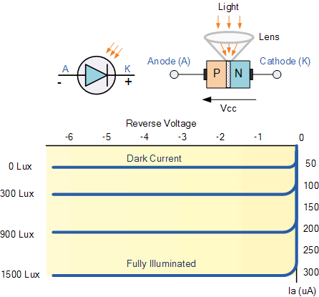
Light sensing: Photodiodes
Most common type of light sensing mechanism
When voltage is applied in reverse to an ideal diode, no current flows
But some small amount of current leaks for real-world photo diodes
Proportional to light levels!

Slide 42
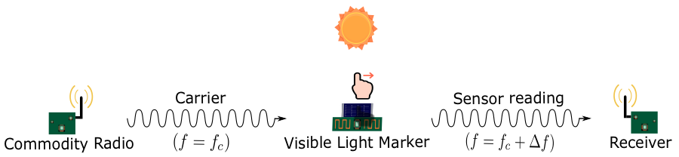
Battery-free Visible Light Sensing

Slide 43
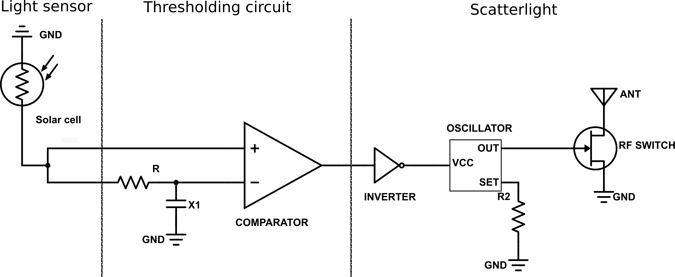
Visible Light Marker Schematic
Light sensing
Digitisation
Communication without processing

Slide 44
Comparators represent extreme form of quantization
Analog Comparator: Performs comparison of a signal value against a threshold and produces a binary value as a result
What is the sensor function?

Slide 45
Comparators represent extreme form of quantization
Analog Comparator: Performs comparison of a signal value against a threshold and produces a binary value as a result
What is the sensor function? f : R → {0, 1}

Slide 46
Comparators represent extreme form of quantization
Analog Comparator: Performs comparison of a signal value against a threshold and produces a binary value as a result
What is the sensor function? f : R → {0, 1}
What is advantage?

Slide 47
Comparators represent extreme form of quantization
Analog Comparator: Performs comparison of a signal value against a threshold and produces a binary value as a result
What is the sensor function? f : R → {0, 1}
What is advantage? Lower power consumption. Can be directly connected to a GPIO/Pin of microcontroller (acts like a 1-bit ADC)

Slide 48
Noise in sensors and measurement
What do you mean by noise?

Slide 49
Noise in sensors and measurement
What do you mean by noise? A part of the signal which we do not want. If we want to measure x(t), and we ended up measuring x’(t) what is the noise?

Slide 50
Noise in sensors and measurement
What do you mean by noise? A part of the signal which we do not want. If we want to measure x(t), and we ended up measuring x’(t) what is the noise? n(t) = x'(t) − x(t)
What is actual measurement? X(t) + n(t)
Noise is the side effect of sensor not measuring exact;y what it is supposed to measure. Contributors many like sensor imperfection, quantization errors etc

Slide 51
How do you identify what type of sensor?
You need to learn how to read datasheets. They contain all the important information. Power, voltage, analog versus digital and others
Accelerometer: ADXL335 Datasheet
Accelerometer: ADXL345 Datasheet
Notes:
Why do the IoT platforms suffer from this energy challenge? To understand this, we investigate the architecture of the IoT device. We show this architecture in the figure on the slide. It consists of a series of stages that enable us to sense physical phenomena, process and transmit the sensor information through a transceiver such as ZigBee/BLE/LoRa.
This architecture has remained unchanged over the past two decades. We find that during this time, sensors have become exceeding efficient. Today, we find sensors such as an accelerometer or a temperature sensor consumes just a few tens of microwatts of power consumption. However, we find that rest of the architecture components that are shown in red colour remain significantly energy expensive. To understand the reason for this significant energy asymmetry, we look at the following slide.

Slide 52
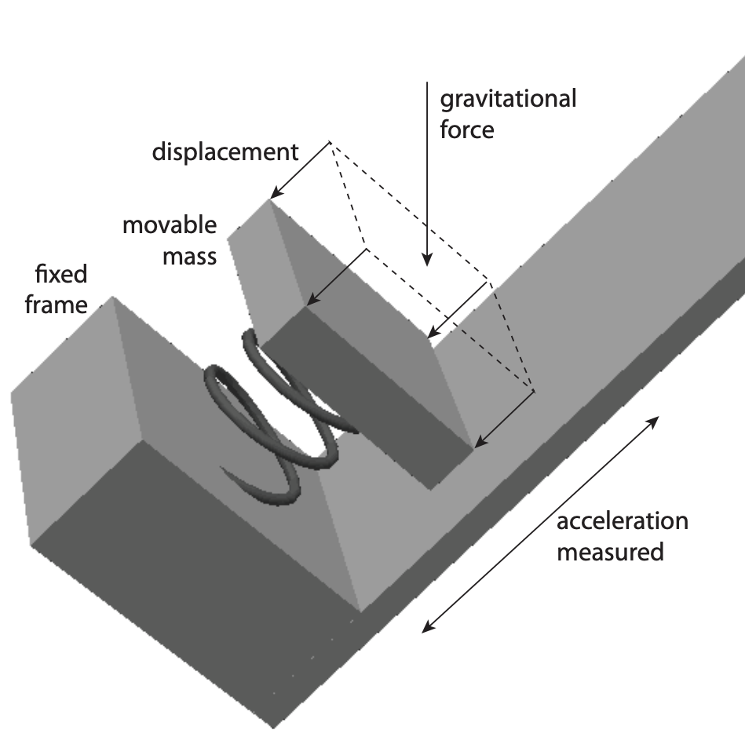
Motion sensing: accelerometers
Accelerometers are sensors that measure proper acceleration. An acceleration of object as observed by an observer in free fall
Accelerometer measure acceleration together with gravitational force

Slide 53
Motion sensing: accelerometers
Sensor circuit measures the position of fixed mass in the frame
Mass moves in any direction, it gets displaced, this results in displacement of mass which is measured to determine the acceleration
What happens if the object with accelerometer free-falls?

Slide 54
Motion sensing: accelerometers
What happens if the object with accelerometer free-falls?
Orientation?
Vertical, Horizontal, Upside Down
Upside down: To an observer in free fall, this looks exactly as if the assembly were accelerating upwards at the acceleration of gravity, which is approximately g = 9.8 meters/second2

Slide 55
Motion sensing: accelerometers
Accelerometer can be used to measure the tilt. Combination of acceleration and gravity is called proper acceleration and can be challenging to separate out

Slide 56
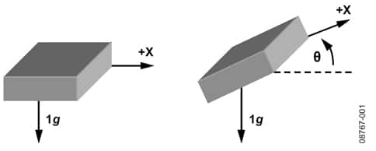
Motion sensing: accelerometers
Accelerometers usually measure in g’s
Where 1 g equals acceleration due to Earth gravity
Determining distance from acceleration is possible
But messy. Error is squared when integrating
Needs careful filtering and is only accurate over short periods
Often fills in gaps between GPS samples (or other localization systems)
Accelerometers also work as tilt sensors
Constantly sensing pull of gravity
$A[x] = 1 g ∗ sin⁡(θ)$

Slide 57
Modelling of a digital accelerometer
Assume,
x is proper acceleration
L ∈ R is the minimum measurable proper acceleration
H ∈ R is the maximum measurable proper acceleration
b ∈ N is the number of bits of the ADC
f : (L, H) → {0, . . . , 2 ^{b} − 1}

Slide 58
Measuring of acceleration on three axis
Today, accelerometer are implemented in silicon. Silicon fingers are deformed under gravitational pull or acceleration. Circuit measures the deformation
Measure three axis?

Slide 59
Measuring of acceleration on three axis
Today, accelerometer are implemented in silicon. Silicon fingers are deformed under gravitational pull or acceleration. Circuit measures the deformation
Measure three axis? Three accelerometers (different orientation) together to measure the three axis

Slide 60
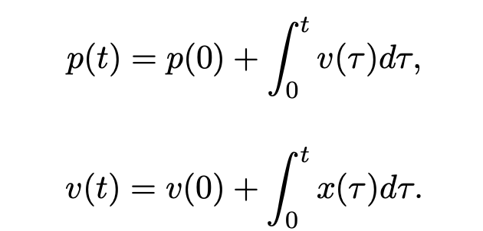
Measuring position, velocity from accelerometer
Position of the object over time be p: R₊ → R, with initial position p(0)
Let the velocity of the object be v : R₊ → R, with initial velocity v(0)
Let the acceleration be x: R₊ → R.

Slide 61
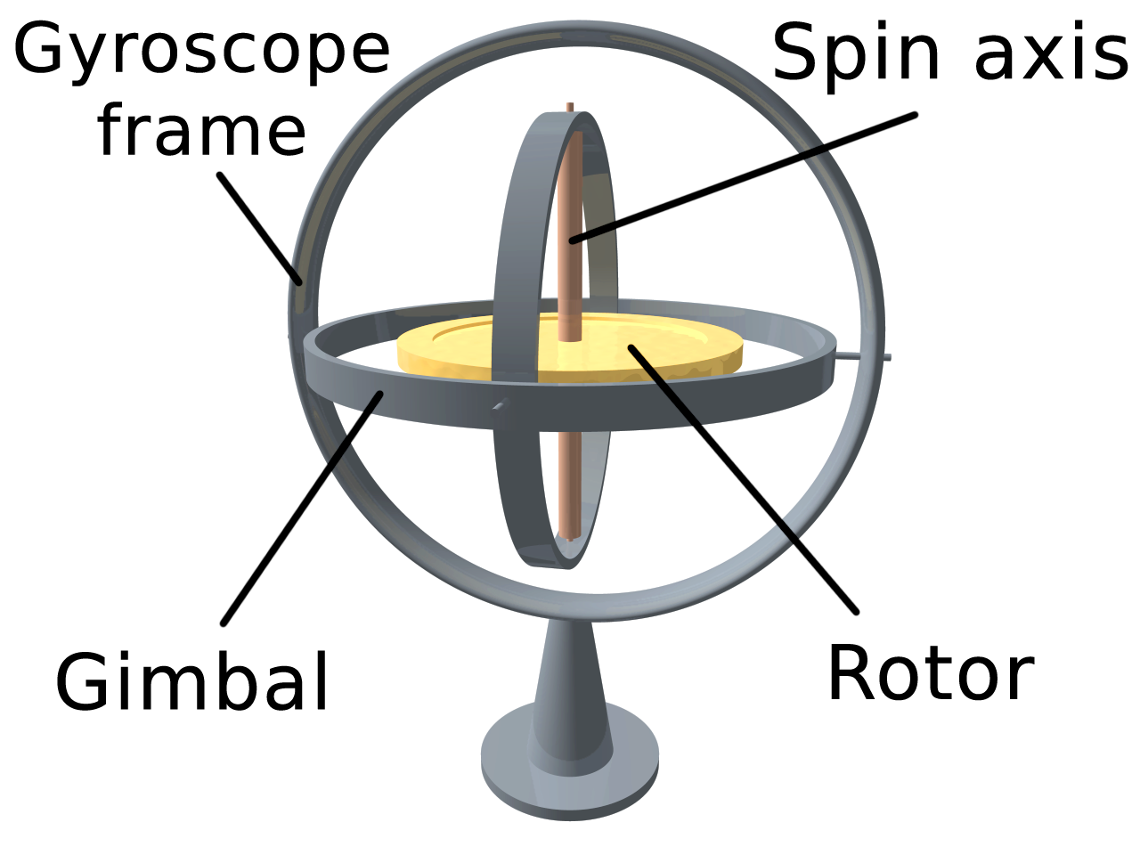
Measuring rotation using gyroscope
Gyroscope help to measure rotation or change in orientation
They are not affected by gravitational field
Gyroscope are bulky rotating devices, or modern counterparts which are MEMS based leveraging optical or electromagnetic properties to detect minute changes in the orientation of the device

Slide 62
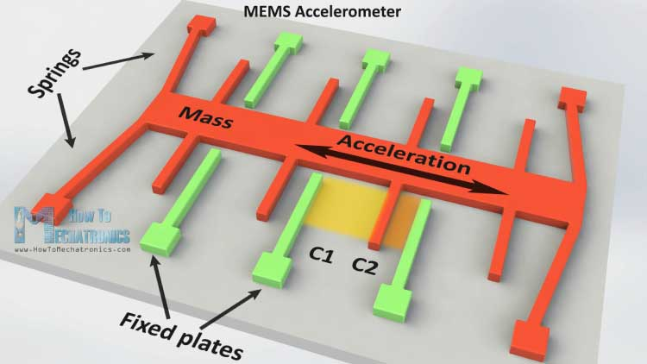
Microelectromechanical Systems (MEMS)
Mechanical structures embedded in an IC and 1 to 100 micrometers in size

Slide 63
Motion sensing: Inertial measurement unit (IMU)
IMUs (a.k.a 9 degree-of-freedom, 9DOF) track motion of a device
Acceleration (X, Y, Z axes)
Rotation (X, Y, Z axes)
Magnetism (X, Y, Z axes)
Sometimes 6DOF with Acceleration + one of the others
Intelligent sensing: combines multiple sensors, ADCs, and computation with a wired interface
9 analog inputs would otherwise be too many
Can be used to track motion, determine transportation method
Smartphones, Robotics, etc.

Slide 64
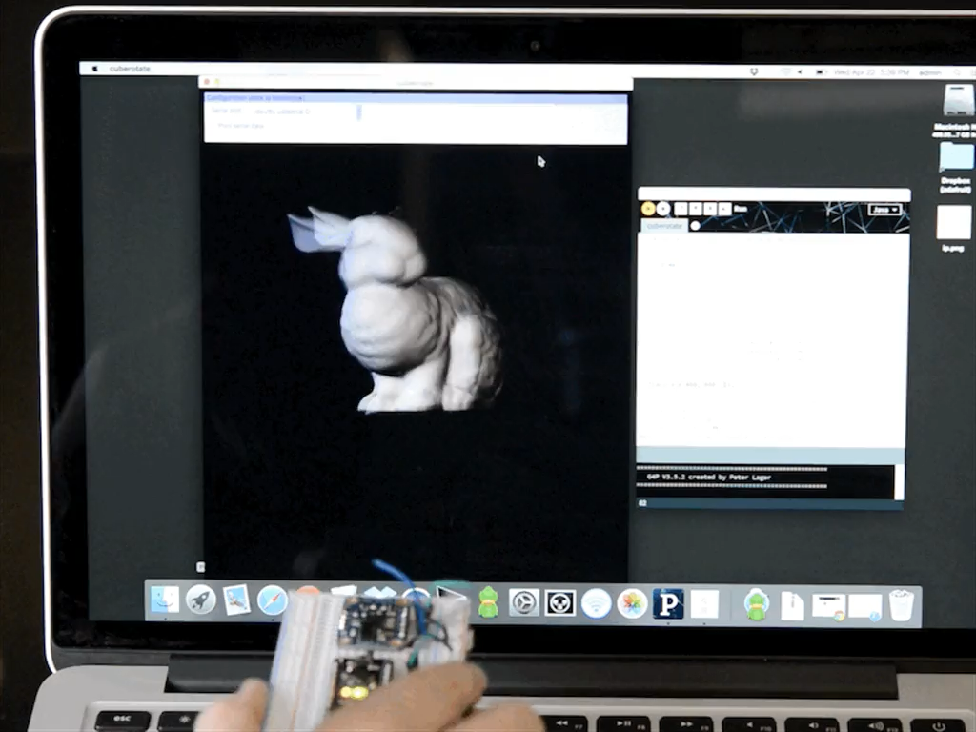
Motion sensing: Inertial measurement unit (IMU)
Courtesy: Apple

Slide 65
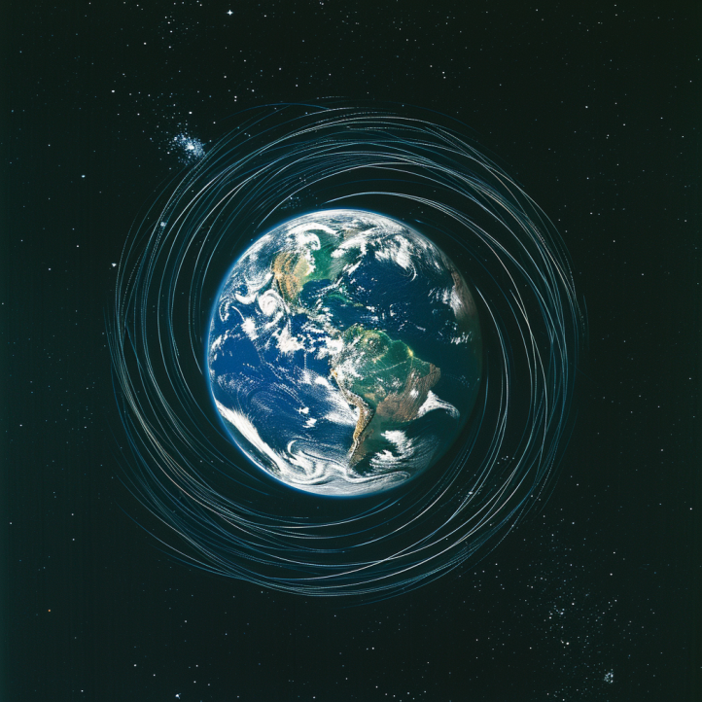
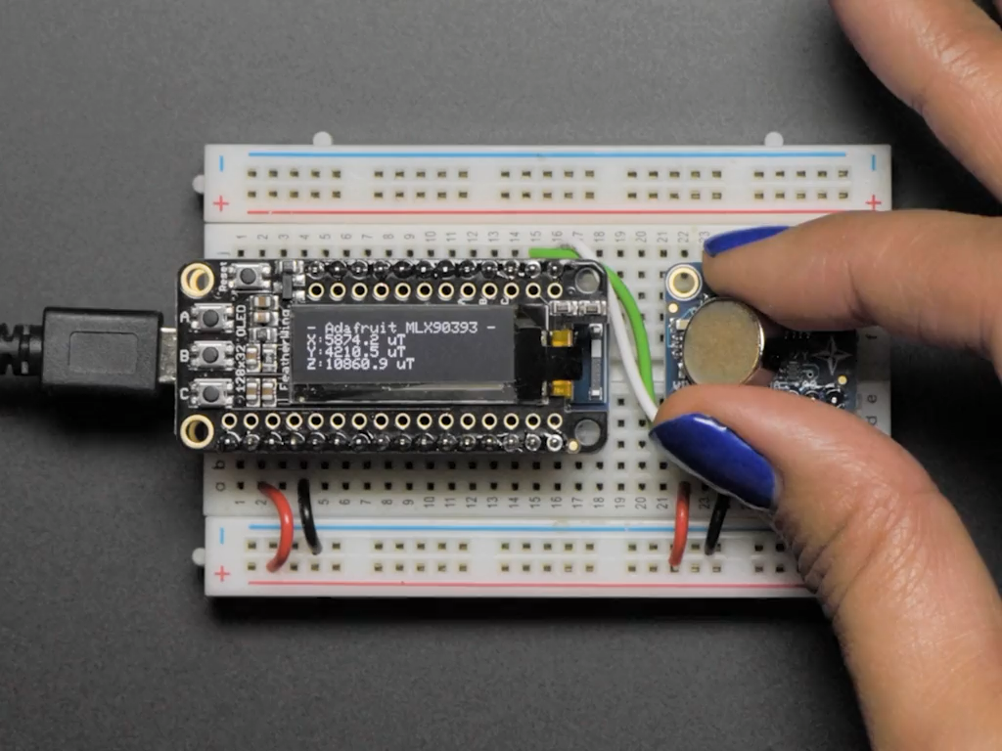
Other sensors: magnetic field (magnetometer)
Measures the magnetic field. Usually used in devices as a compass
Detect Earth’s magnetic field orientation
Satellites also often use magnetometers for localization
Courtesy: Adafruit

Slide 66
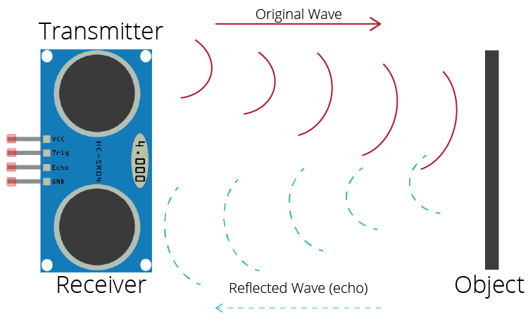
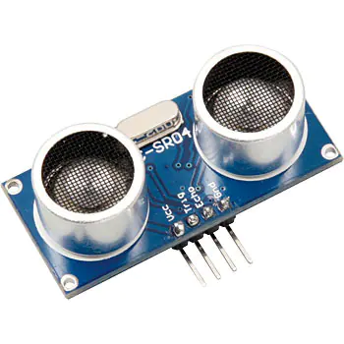
Active sensing: Ultrasound sensor
Emits high frequency sound waves from sensor which bounces from objects that are present in the environment
Estimates distance, proximity by measuring time taken for sounds waves to bounce back and propagate back to the ultrasound device
Power consuming, though can be used on IoT devices
Common application: Robotics, obstacle detection, water level sensing

Slide 67
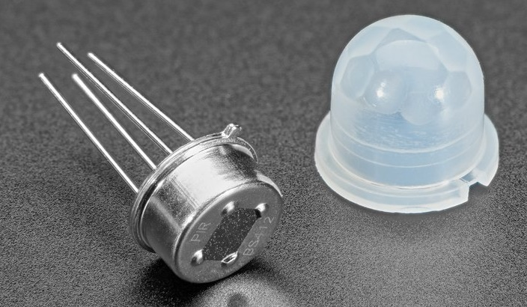
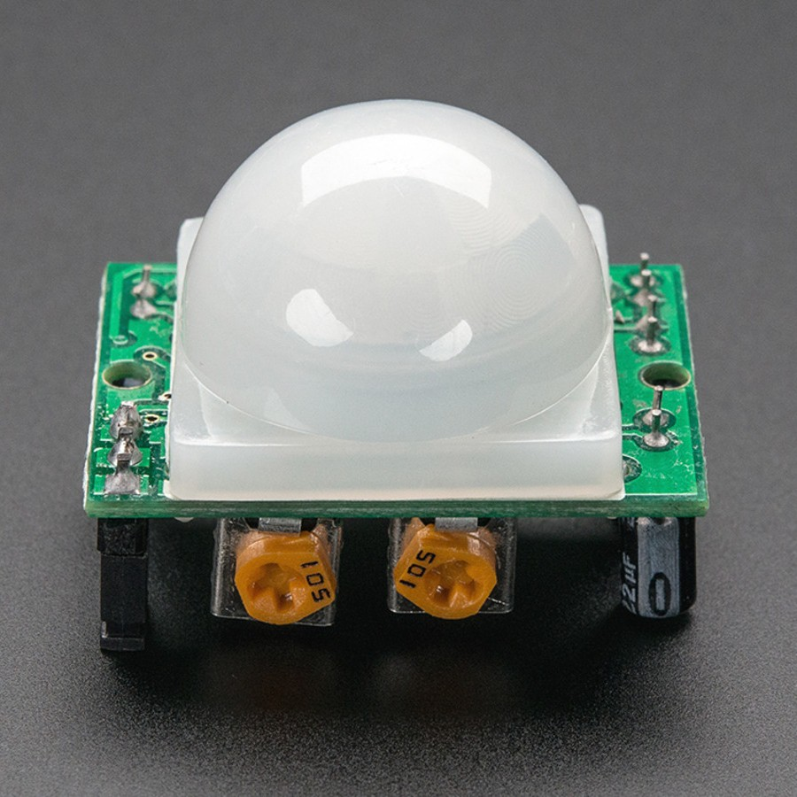
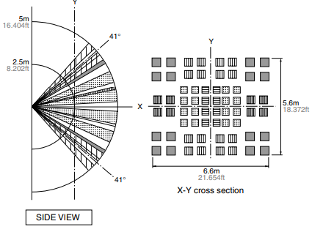
Passive Infrared (PIR) sensor
Detect movement in the environment
By detecting change in IR levels
Often come with plastic lens cover to improve field of view and range

Slide 68
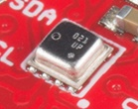
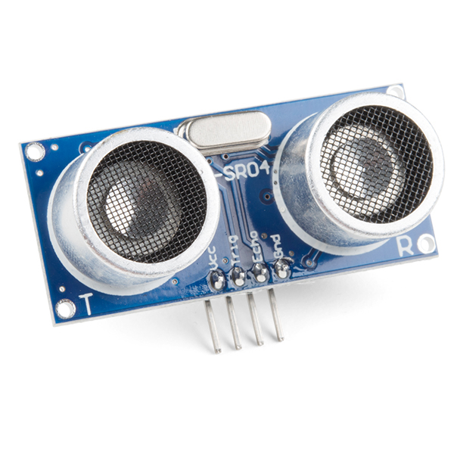
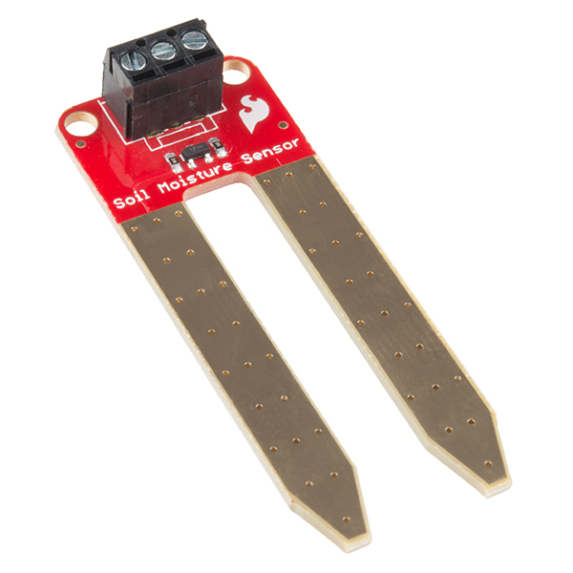
There are even more types of sensors
Environment: Pressure, Humidity, Air Velocity, Air Quality
Rotation: Gyroscope
Distance: Ultrasonic, Lidar, or Radar
Biometric: Pulse Oximeter, Heart Rate
Agricultural: Soil moisture

Slide 69
There are even more types of sensors
Environment: Pressure, Humidity, Air Velocity, Air Quality
Rotation: Gyroscope
Distance: Ultrasonic, Lidar, or Radar
Biometric: Pulse Oximeter, Heart Rate
Agricultural: Soil moisture

Slide 70
Power Management, Energy-Efficiency
Notes:
++ Over the past few years, I have designed several backscatter and beyond backscatter systems that precisely overcome these critical challenges that have limited the widespread deployment of backscatter on IoT devices.
++ The research vision that I have pursued and would like to pursue as a faculty member is to enable a massive deployment of IoT devices by bridging the energy asymmetry between sensing, computation and communication blocks by designing novel platforms and communication mechanisms. I am going to describe some of my research contributions next.

Slide 71
Battery-life, Power Consumption

Slide 72
Quick revision of important terms and their unit
Voltage: Volts (V): the SI unit of electromotive force
Current: Ampere or “amp” (A) is the SI unit of current
Power (W): Voltage (V) x Current (A)
Energy (Joule): Power x Time.
Example:
A device running at 1V draws 1A.
The power consumption is therefore 1W
Energy consumed in 1s is 1J

Slide 73
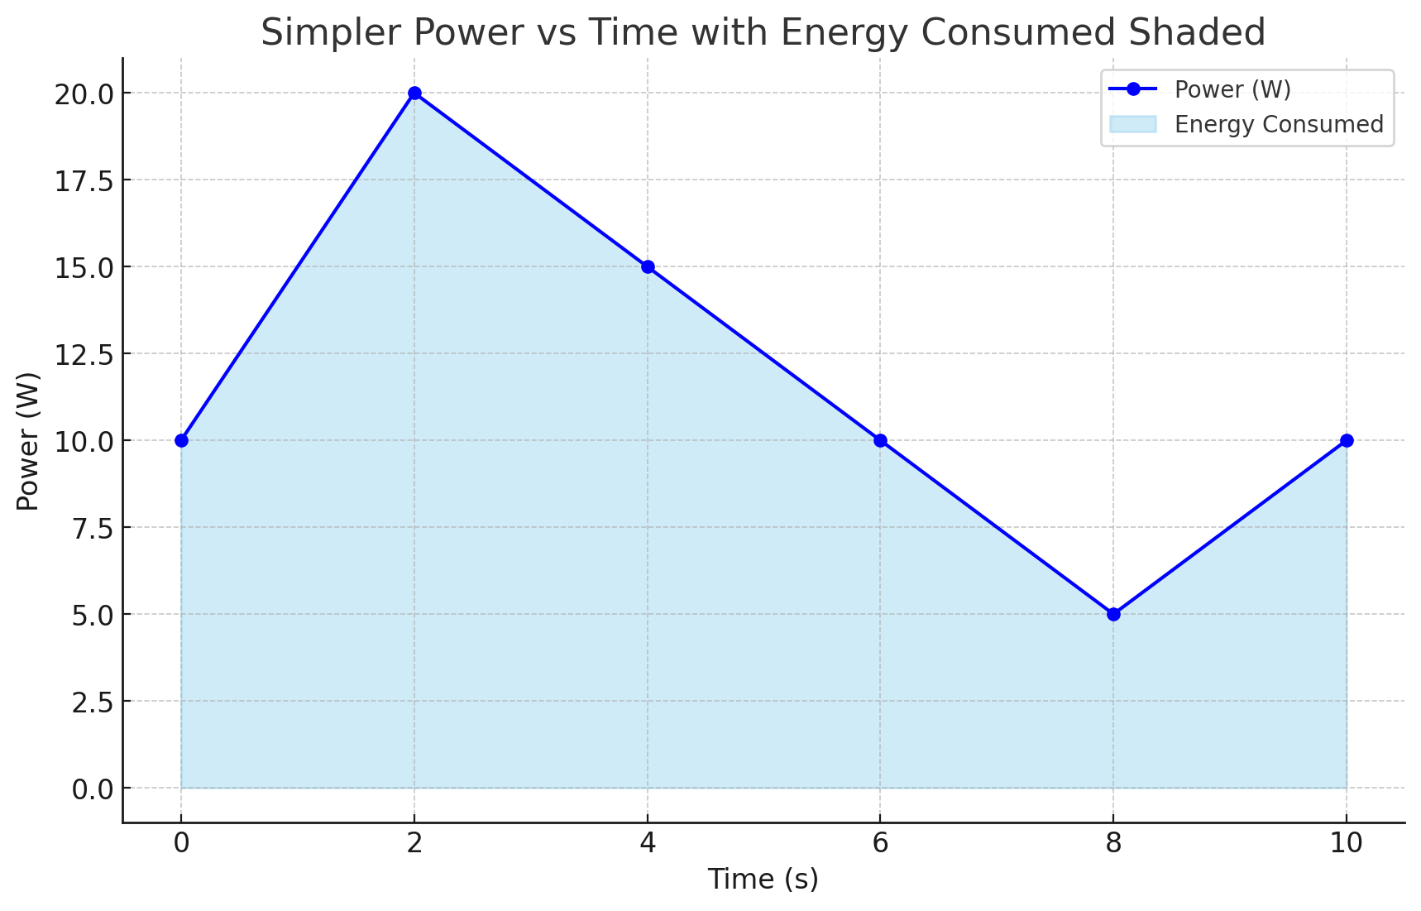
Relationship between power, energy and time

Slide 74
How do you measure the capacity of a battery?
The watt-hour (symbolized Wh) is a unit of energy equivalent to one watt (1 W) of power that is expended for one hour (1 h) of time.
Macbook Pro 16 Inch: 99.6 Watt-hour
iPad pro 12.9 Inch: 40.88 Watt-hour
An ampere-hour or amp-hour (Ah) is a unit of electric charge equal to the charge transferred by a steady current of 1A flowing for one hour:
AA Energizer Alkaline: 2500 mAh (1.5V), 3.75Wh

Slide 75
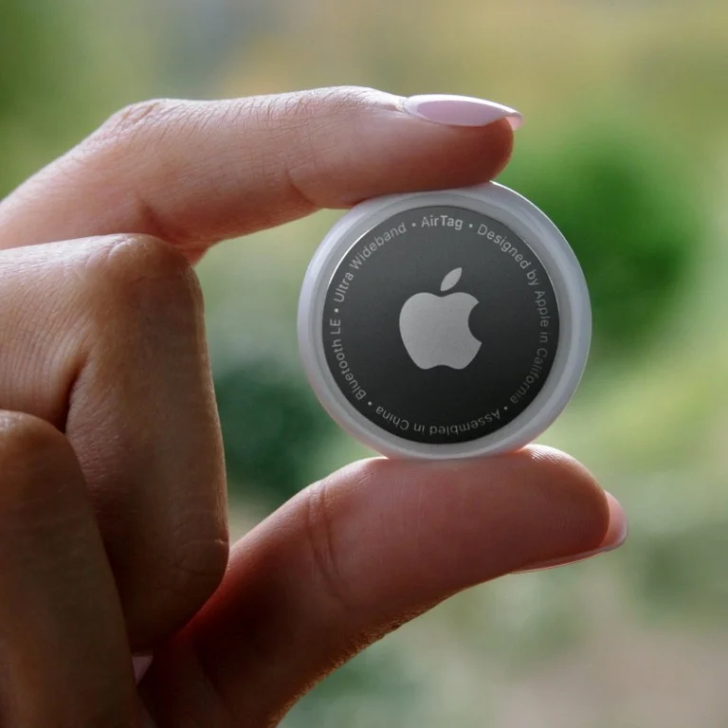
Battery Capacity: Apple AirTag

Slide 76
Battery Capacity: Apple AirTag
Coin Cell: 240 mAH

Slide 77
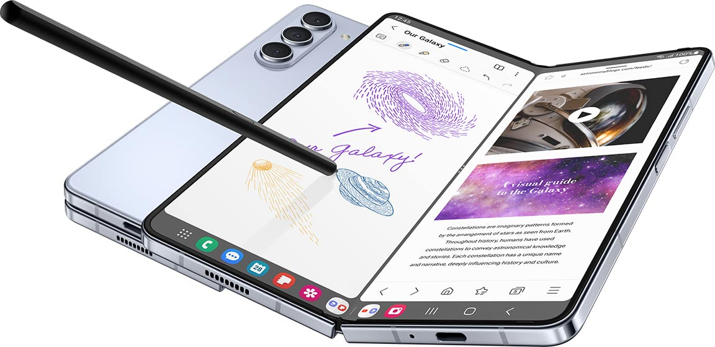
Battery Capacity: Smartphone

Slide 78
Battery Capacity: Smartphone
Lithium Ion: 3400 - 6000 mAH

Slide 79
Energy Characteristics of LCD Display
Most of the power in an LCD display is consumed by the backlight, the light filter requires comparatively less power.
B Anand, K Thirugnanam, J Sebastian, PG Kannan, AL Ananda, MC Chan, RK Balan, “Adaptive display power management for mobile games,” ACM International Conference on Mobile Systems, Applications, and Services (Mobisys) 2011.

Slide 80
Energy Characteristics of OLED Display
OLED display functions without a backlight
OLED displays consume less power than a LCD display when the image is dark, but more when the image is bright
Displaying different color consumed different amount of energy

Slide 81
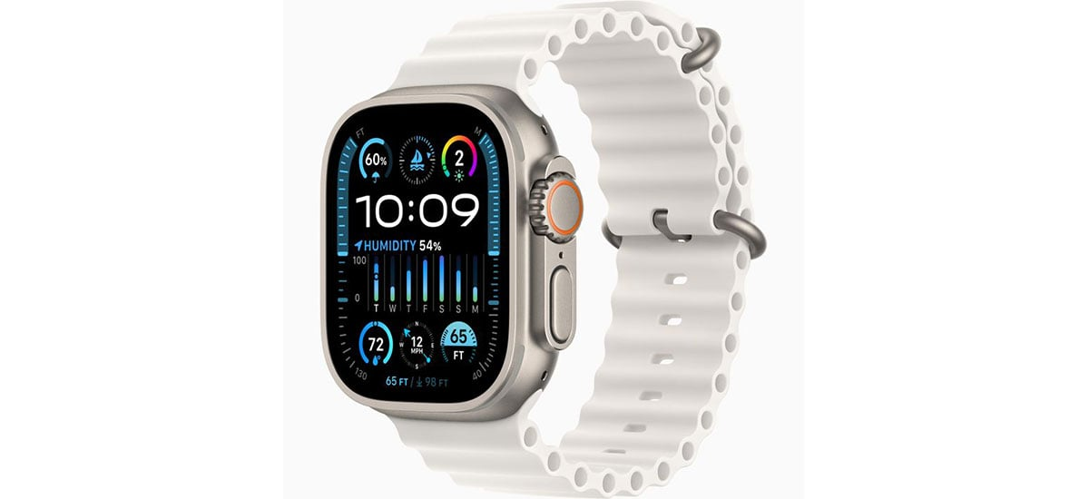
Battery Capacity: Smartwatch

Slide 82
Battery Capacity: Smartwatch
Smart watch: 400-600 mAH

Slide 83
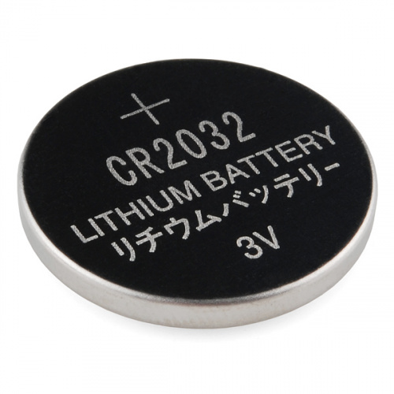
What is the capacity of the battery?
How do we calculate the lifetime of the battery in IoT devices?
We express battery capacity commonly in milliampere-hour (mAH)
Coin cell (CR2032): 240 mAh, Flexible battery (Molex): 10 mAh
How long would battery last under different device load:
Current drawn | Lifetime
240 mA | 1 h
120 mA | 2 h
1 mA | 240 h
Coin cell battery
CR 2032 (240 mAh)

Slide 84

Expected lifespan of a battery in an IoT devices?
Coin cell (CR2032): 240 mAh, Flexible battery (Molex): 10 mAh
What is the battery life under different device loads:
Coin cell battery
CR 2032 (240 mAh)
Flexible Battery
(10 mAh)
Component | Current draw
Microcontroller | 200 uA
Accelerometer | 10 uA
WiFi Radio | 15 mA
Bluetooth radio | 1 mA

Slide 85
Expected lifespan of a battery in an IoT devices?
Coin cell (CR2032): 240 mAh, Flexible battery (Molex): 10 mAh
What is the battery life under different device loads:
Coin cell battery
CR 2032 (240 mAh)
Flexible Battery
(10 mAh)
Component | Current draw | Flexible Battery | Coin cell
Microcontroller | 200 uA | 50 h | 1200 h
Accelerometer | 10 uA | 1000 h | 24000
WiFi Radio | 15 mA | 45 mins | 16 h
Bluetooth radio | 1 mA | 10 h | 240 h

Slide 86
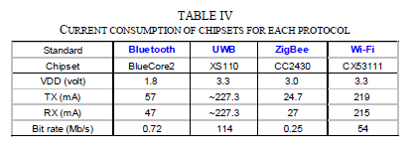
Lifespan estimation for wireless networking
A mobile device with a capacity 9.62Wh transmits continuously on:
WiFi:
Considering only network energy consumption
Power consumption: 3.3V*219mA = 722.7 mW
Duration = 9.62/0.7227 = 13.3hrs
In practice, the duration is much shorter
Bluetooth: (1.8V * 57mA = 102.6mW)
Duration = 9.62/(1.8*0.057) = 93.76hrs

Slide 87
Spikes in the power consumption of smartphones are due to wireless networking events
WiFi state transition for beacon communication is (relatively) fast
However, state transition for data communication is (still) slow due to driver/software overhead

Slide 88
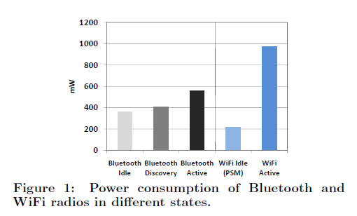
Different transmission states for wireless networking
Devices rarely transmit continuously.
Having different power states allow power consumption to be reduced

Slide 89
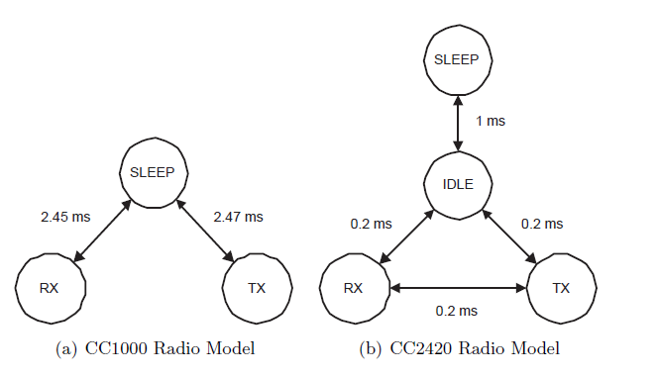
Different states of a radio transceiver
Energy conserved by placing the radio transceivers into low power states when they are not active

Slide 90
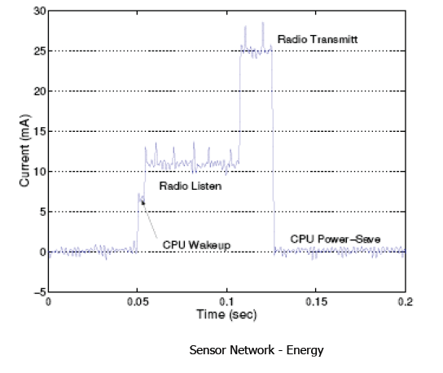
Current consumption for a wireless embedded device for various states of the radio transceiever
What are the desirable properties for radio to operate in low power?

Slide 91
Examples of Duty Cycling (Network Interface)
Compare WiFi (100Mbps) and ZigBee/802.15.4 (250kbps), 1s cycle, assume same voltage
WiFi, three states;
Transmit: 280 mA
Receive: 180 mA
Idle: 10 mA
802.15.4, three states:
Transmit: 30 mA
Receive: 18 mA
Idle: 0.426mA

Slide 92
Examples of Duty Cycling (Network Interface)
100% utilization (50% transmit, 50% receive)
WiFi: (180+280)/2 = 230mA
802.15.4: (18.8+30)/2 = 24.4mA (10.6% of WiFi)
10% utilization (5% transmit, 5% receive, 90% idle)
WiFi: 230*0.1 + 10*0.9 = 32mA
802.15.4: 24.4*0.1 + 0.426*0.9 = 2.823mA (8.8% of WiFi)
1% utilization (0.5% transmit, 0.5% receive, 99% idle)
WiFi: 230*0.01 + 10*0.99 = 12.2mA
802.15.4: 24.4*0.01 + 0.426*0.99 = 0.6657mA (5.46% of WiFi)

Slide 93
Energy consumption calculation for an embedded device

Slide 94
Lifespan calculation for a embedded device
A sensor node wakes up every minute to perform a short communication session. Over a 60‑second cycle, the radio transitions through three states: deep sleep, idle (listening), and transmit.
• Cycle Duration: 60 seconds
• State Durations and Current Draws:
• Deep Sleep: 55 seconds at 0.01 mA
• Idle (Listening): 2 seconds at 5 mA
• Transmit: 3 seconds at 50 mA
Battery: 3000 mAH

Slide 95
SensorTag: Current consumption for radio states

Slide 96
Lifespan calculation for a embedded device
Consider a SensorTag that primarily uses its microcontroller for periodic sensor readings and data processing. The microcontroller operates in two key modes: Deep Sleep (ultra-low power) and Active Mode (performing sensor readings and processing). In this example, the SensorTag wakes up every minute to perform its tasks.
• Cycle Duration: 60 seconds
• Power Modes and Current Draws:
• Deep Sleep Mode: 55 seconds at 0.01 mA (10 µA)
• Active Mode: 5 seconds at 3 mA
Battery Capacity: 500 mAH

Slide 97
Lifespan calculation for a embedded device
Imagine a wireless sensor network deployed in a remote forest to monitor environmental conditions (temperature, humidity, etc.). Each sensor node is battery-powered and must operate reliably for several years without maintenance.
Microcontroller (MCU):
• Active Mode: Used for sensor reading, data processing, and control logic.
• Deep Sleep Mode: Consumes only a few microamps when idle.
Wireless Transceiver (e.g., LoRa or Zigbee):
• Transmit Mode: Active for sending data packets.
• Standby/Sleep Mode: Consumes negligible power when not transmitting.
• Sensors: Operate briefly to take measurements.
• Battery: A non-rechargeable lithium battery with a capacity of 2400 mAh.
Operational Cycle (Duty Cycle):
The node wakes up every 10 minutes (600 seconds) to:
1. Activate the MCU for 1 second at 15 mA (for sensor reading and processing).
2. Activate the Transceiver for 0.1 second at 40 mA (to transmit the data).
3. Remain in Deep Sleep for the remaining 598.9 seconds at 10 µA (0.01 mA).

Slide 98
Low-Power Wireless Transmissions through Backscatter Communication

Slide 99
Basics of backscatter communication
Vary between absorbing or reflecting signal to modulate data
Wireless transmissions at microwatts of power draw (10000x energy savings)
Frequency bands: 400 MHz, 900 MHz, 2.4 GHz
Ambient RF signal
Antenna
Reflected (backscatter) signal
RF Switch
Modulating Signal (Digital)
Backscatter tag
Reader/ Receiver

Slide 100
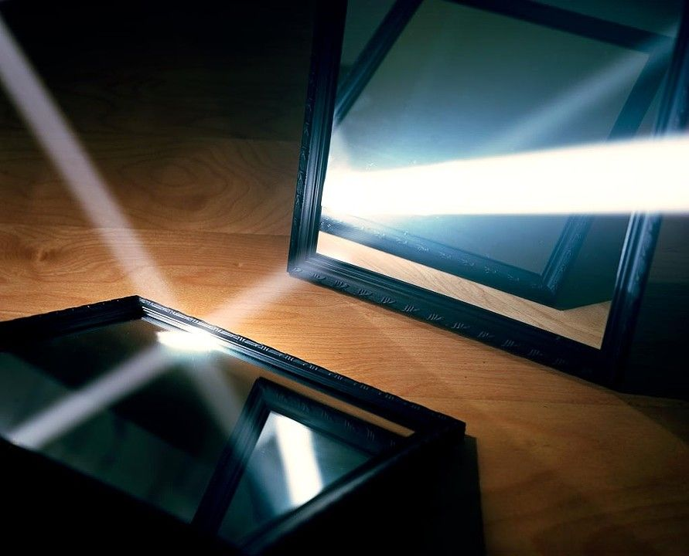
One way to understand backscatter transmissions
Notes:
++ While we are deploying an enormously large number of IoT devices, I claim that very little attention is being paid to their energy challenge.
++ Today, most IoT devices are very energy expensive, and consequently, they rely on bulky batteries such as AA/AAA sized batteries for their operation. Even when operating on these batteries, they require frequent replacement of the exhausted batteries. This can be challenging when performed at a massive scale, especially considering that we may have a trillion embedded device deployed in the world.
++ Further, it can also harm the environment. These batteries use toxic chemicals, which means now we can have billions of toxic chemicals laden batteries that would be disposed of in landfills. This is especially important as sustainability has become an essential aspect across the world; in fact, imperial college was celebrating sustainability week.

Slide 101
Backscatter transmits at (up to) 10000x lower power consumption than conventional radios
Backscatter through absorption or reflection of ambient wireless signals enables wireless transmissions at microwatts of power consumption
Ambient RF signal
Antenna
Reflected (backscatter) signal
RF Switch
Modulating Signal (Digital)
Backscatter tag
Receiver
Notes:
Backscatter communication actually help us overcome this limitation

Slide 102
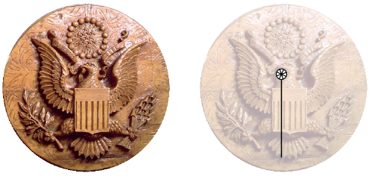
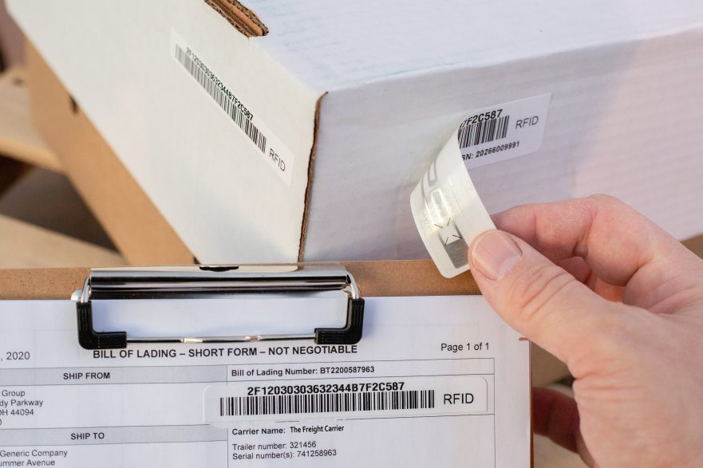
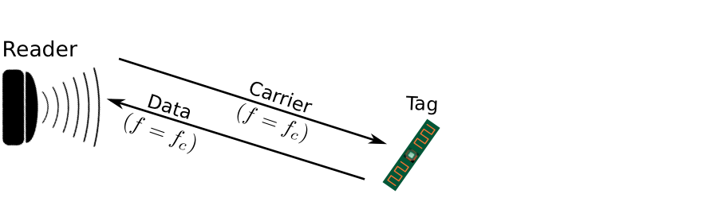
Backscatter is not a new transmission mechanism
First backscatter system: Great seal bug (The Thing) 1945
RFIDs: one of the most widely deployed backscatter system
Great Seal Bug (Backscatter device embedded for spying)
RFID System

Slide 103
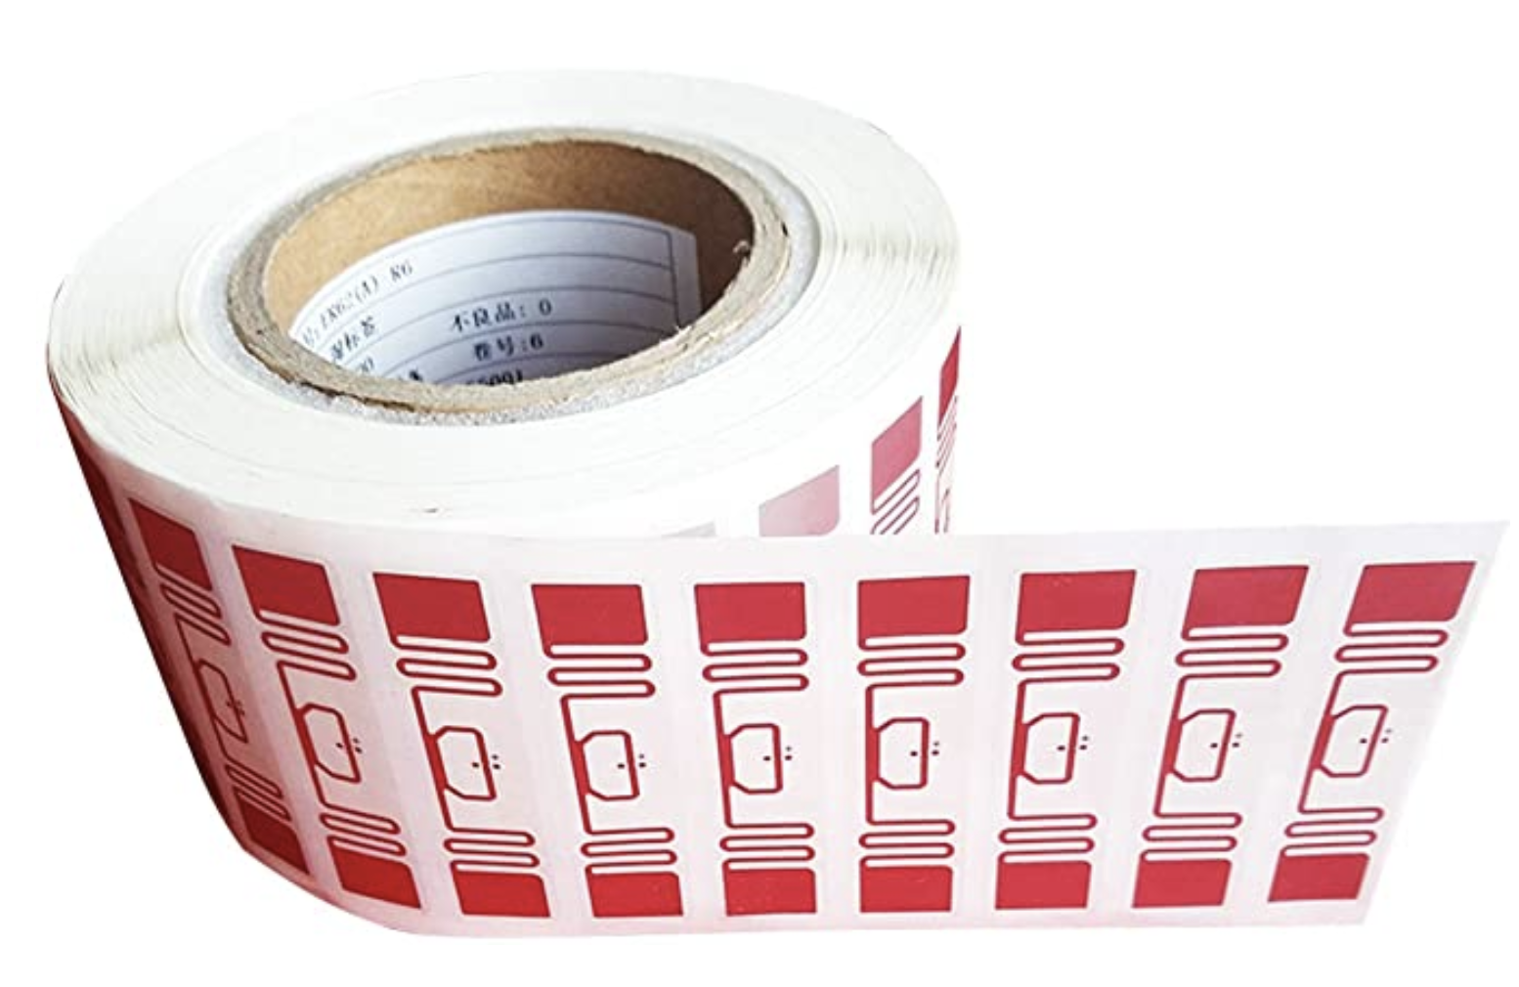
RFID is everywhere nowadays
Fundamental design principle is asymmetry
Extremely simple, cheap tags
Complex readers

Slide 104
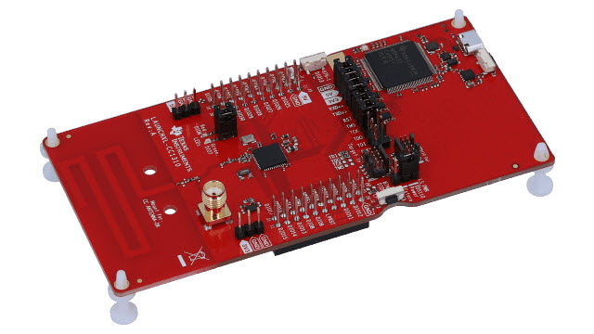

LoRea bridges the energy asymmetry between communication (TX), sensing and processing
Component | Power Consumption
LoRea (Transmissions) | 70 µW (868 MHz)
Conventional Transceiver | Tens to hundreds of mW’s
Microcontroller (Apollo3) | 100s of µW’s
Sensors | Few to tens of µW’s
Off-the-shelf hardware for transmission and receptions. Tens of USD
Overturn notion that backscatter is a short-range transmission mechanism
LoRea transmits at similar power consumption as a sensor
Texas Instruments CC1310 Launchpad: Receiver
Backscatter Tag Hardware Prototype
(Peak Power of 70 µW)
Notes:
+ Thus, with LoRea, we were able to design a backscatter system that was able to overcome the range and cost limitations that had limited all the existing backscatter system, and had hindered the widespread usage of the mechanism on the IoT devices
.
+ In fact, the backscatter tag even though it was designed using off-the-shelf components is orders of magnitude more efficient than commercial transceivers while supporting orders of magnitude lower power consumption.
+ the entire backscatter setup costs just few tens of USDs, which dramatically lowers the cost of infrastructure required to support the backscatter tags and carrier emitter device.

Slide 105
Let’s look at the battery-life again
Notes:
++ Over the past few years, I have designed several backscatter and beyond backscatter systems that precisely overcome these critical challenges that have limited the widespread deployment of backscatter on IoT devices.
++ The research vision that I have pursued and would like to pursue as a faculty member is to enable a massive deployment of IoT devices by bridging the energy asymmetry between sensing, computation and communication blocks by designing novel platforms and communication mechanisms. I am going to describe some of my research contributions next.

Slide 106
What is the expected lifespan of a battery?
Coin cell (CR2032): 240 mAh, Flexible battery (Molex): 10 mAh
Backscatter transmitter: (LoRea, SENSYS 2017) – 35 uA
Let’s estimate long would battery last under different device load:
Component | Current draw | Flexible Battery | Coin cell
Microcontroller | 200 uA | 50 h | 1200 h
Accelerometer | 10 uA | 1000 h | 24000
WiFi Transmitter | 15 mA | 45 mins | 16 h
Bluetooth Transmitter | 1 mA | 10 h | 240 h
Backscatter Transmitter | 35 uA | 285.7 h | 6857 h

Slide 107

What's next? Embedded systems on harvested energy
𝜇W
Energy harvester
Microwatts of power available to harvest from ambient sources
Notes:
++ The high-power consumption for the IoT platforms also blocks an important and promising direction to enable the sustainable deployment of large-scale embedded devices. This is to eliminate batteries from these platforms altogether. If we eliminate batteries, how do we power these devices?
++We use the fact that ambient energy sources surround us. We are constantly bombarded with radio frequency transmissions such as television, wifi, radio signals, or we have waste heat energy sources, or the indoor light is ubiquitous. All these sources could be harvested to derive energy to power the IoT devices and platforms and eliminate the overhead associated with batteries on these platforms. However, the challenge that we encounter is that we could only derive microwatts of power from these ambient sources, which is sufficient to power the sensors and microcontrollers. However, we need orders of magnitude higher power for operating radio transceivers such as LoRa. This makes it challenging, if not impossible, to power sensors through energy derived from the environment.

Slide 108
Embedded systems on harvested energy
Batteries/Capacitors can potentially be recharged by environmental effects
Some examples
Solar : solar cell
Wind: micro wind turbine can be used to harvest wind energy readily available in the environment in the form of kinetic
Thermal: capture energy from industrial equipment, structures, and even the human body.
Vibration: vibration from engines can stimulate piezoelectric materials, as can the heel of a shoe.
Kinetic: translate movement to change in electromagnetic flux
Radio Frequency (RF): convert ambient RF signal into energy (demo video)

Slide 109
Wireless Networking
Ambuj Varshney
ambujv@nus.edu.sg
Notes:
++ Thank you for inviting me to give this talk
++ In this talk, I will present a pathway that can enable us to make wireless embedded systems ubiquitous. I will describe my previous research efforts that tackle the critical challenges that limit the growth of wireless embedded systems. These are related to the growing energy asymmetry that exists between sensing, computation and communication blocks on these platforms.
++ Finally, I will conclude my talk by covering the research agenda that I would like to work on as a faculty member.

